Slide 1
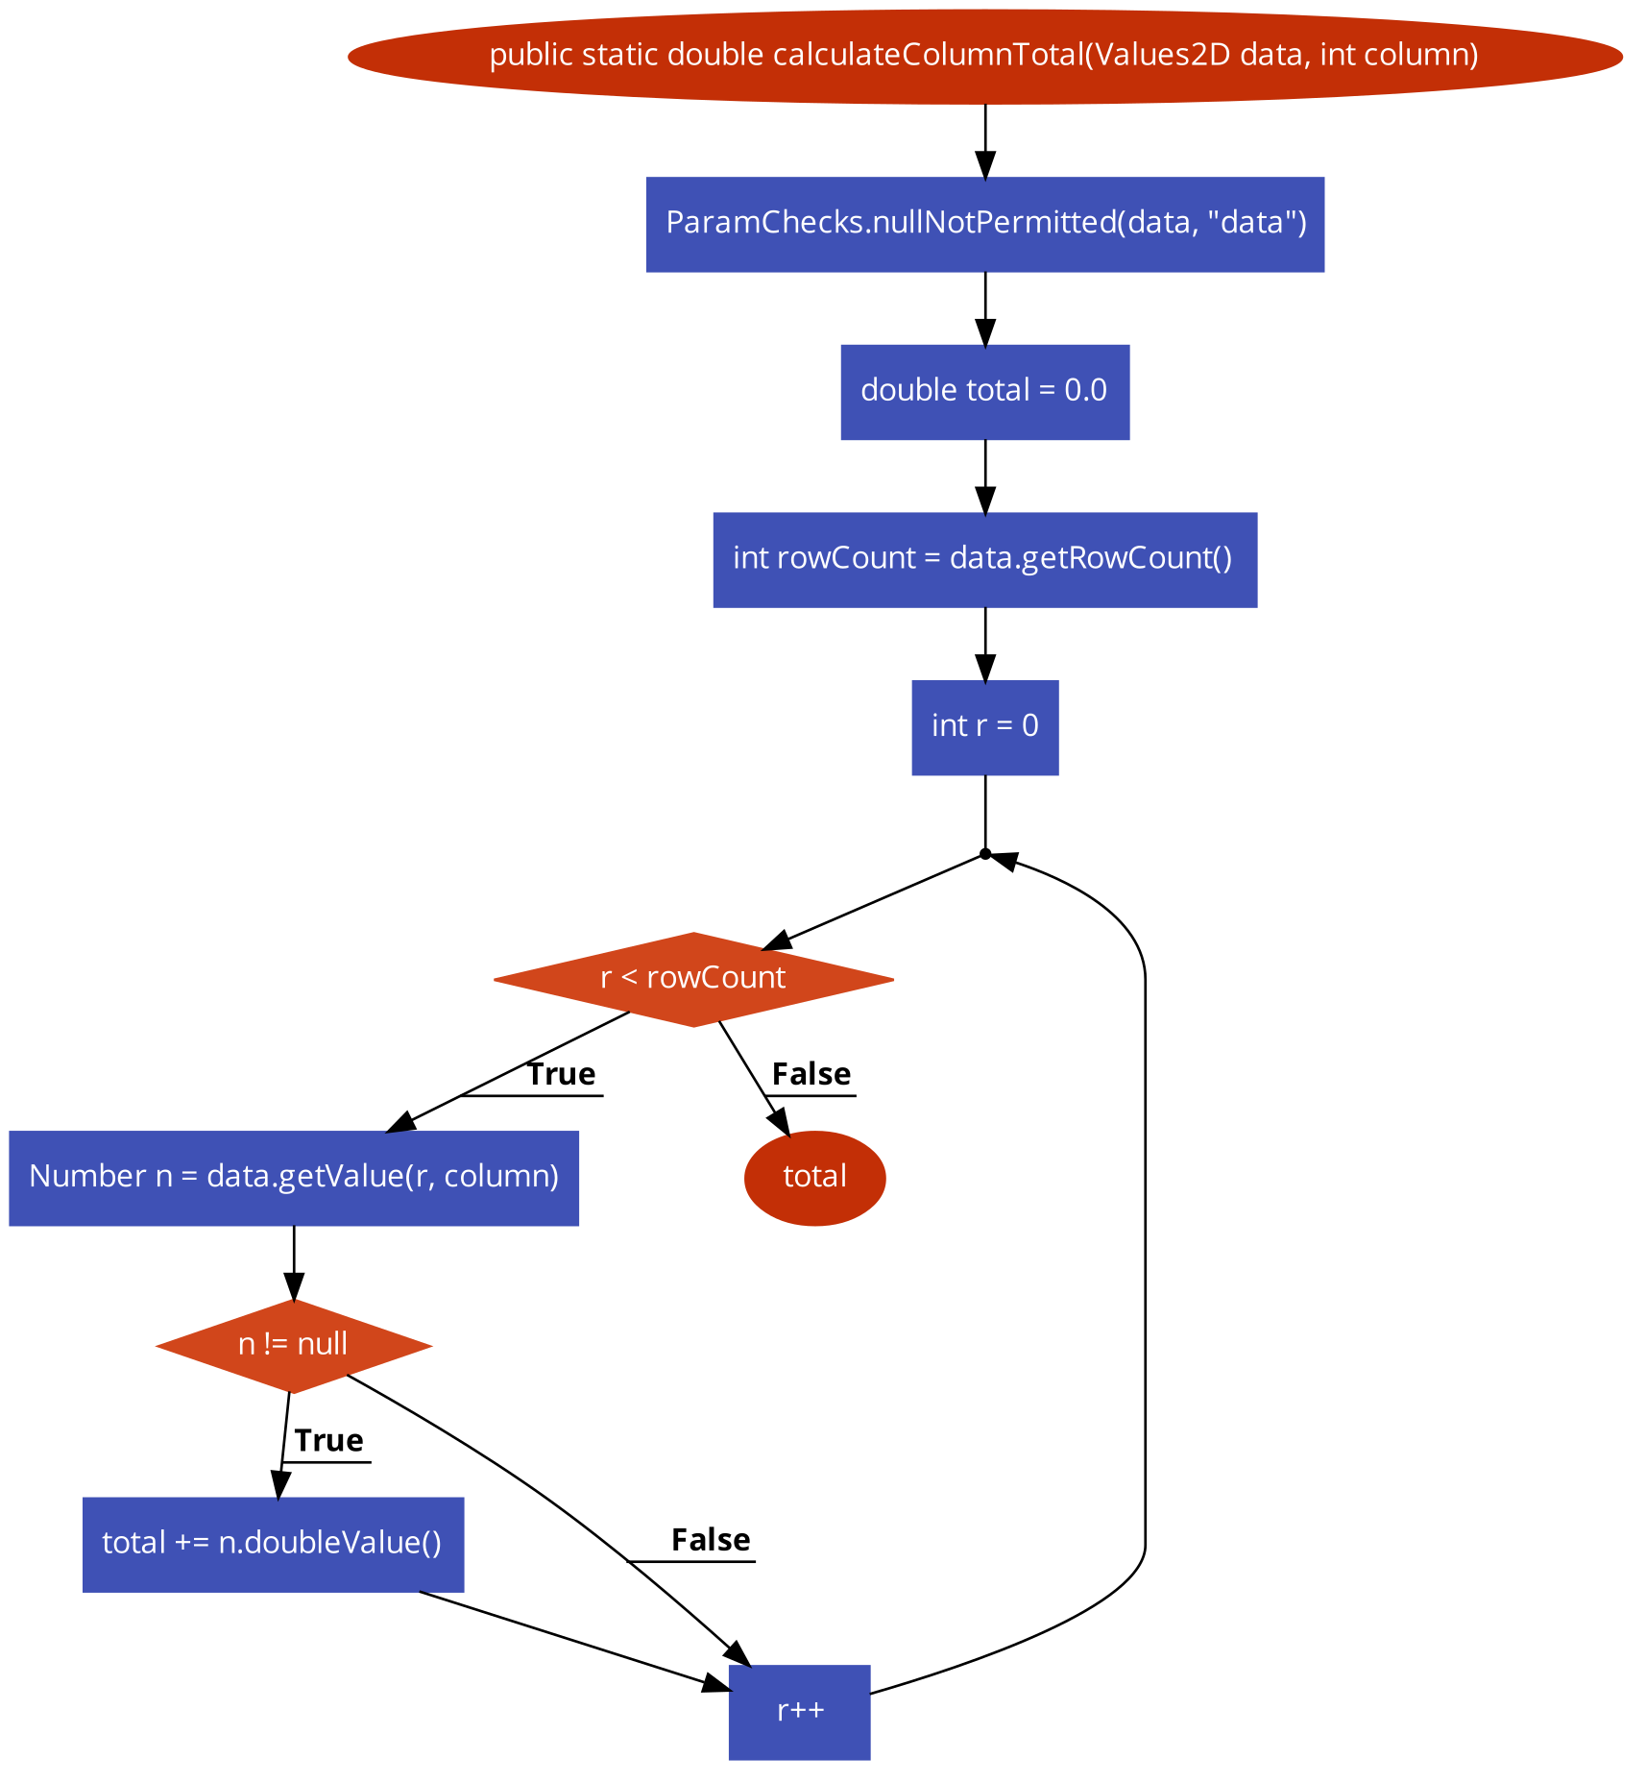
(1,1)
n1
Definition of pairs:
(where value is assigned, where it is used)
n2
(1,3)
n3
n4
n5
(<4, 10>,5), (3,5)
(1,7),(1,7),(<4, 10>,7)
n7
n6
(<2,9>,6)
(7,8)
n8
(<2,9>,9), (7,9)
n9
n10
(<4, 10>,10)

Slide 2
Per Variable
data: (1,3), (1,1), (1,7)
column: (1,7)
total:(<2,9>,6),(<2,9>,9)
rowCount: (3,5)
r: (<4,10>,5), (<4,10>,7), (<4,10>,10)
n: (7,8), (7,9)

